Slide 1

AI Based Prediction of Water Potability for Sustainable Development

Slide 2




Background
Water quality is a critical global public health issue.
This project uses machine learning to predict whether water is safe or unsafe based on chemical indicators (pH, sulfate).
Traditional testing methods are slow and laboratory-based → need for fast, automated prediction systems.
Goal: Build a data-driven water safety prediction model for real-world decision support.

Slide 3


Objectives
The main objective of this project is to develop a machine learning model that predicts water potability using chemical water quality indicators.
Key Objectives:
Build a predictive model to classify water as safe or unsafe
Use key features: pH and Sulfate levels
Apply multiple ML algorithms and compare performance
Improve model robustness using hyperparameter tuning and cross-validation
Minimize false negatives to ensure public safety
Identify the best-performing model for real-world use

Slide 4


SDG Relation
This project directly supports the United Nations Sustainable Development Goals (SDGs), particularly those focused on health and clean water access.
Relevant SDGs:
SDG 3 – Good Health and Well-Being Ensures early detection of unsafe drinking water, reducing health risks caused by contamination.
SDG 6 – Clean Water and Sanitation Supports monitoring of water quality and helps identify non-potable water sources efficiently.
Project Contribution:
Enables fast and automated water quality assessment
Supports data-driven environmental decision-making
Helps improve access to safe drinking water through AI-based prediction

Slide 5
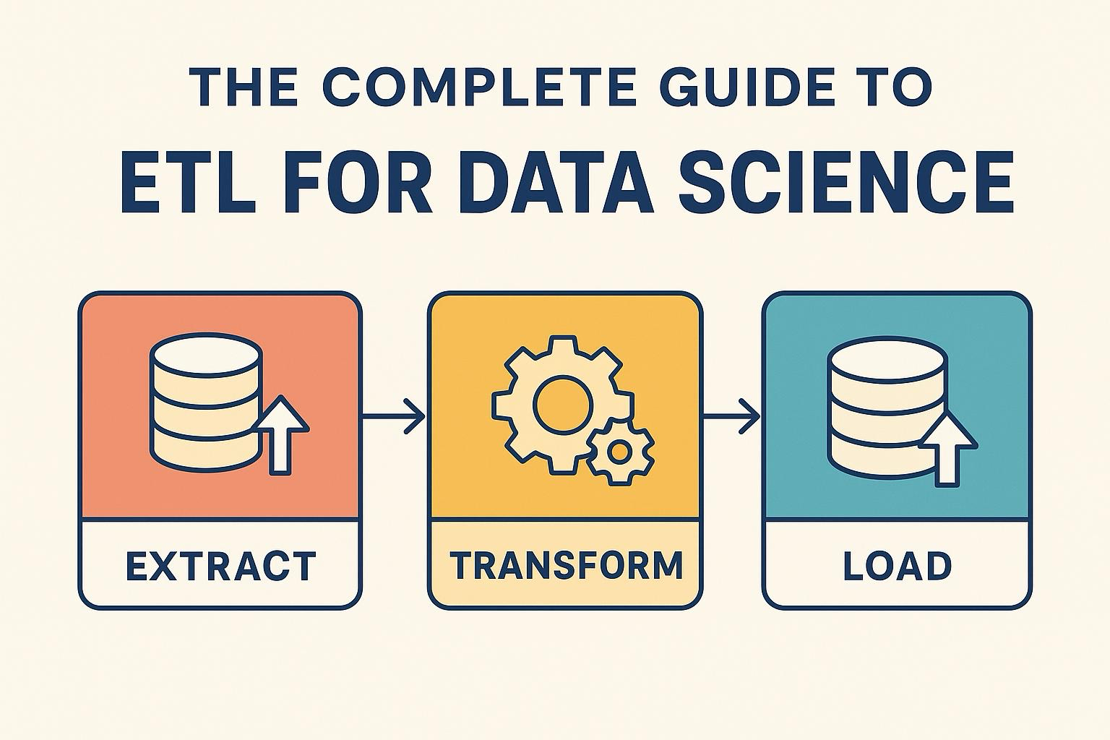
Data
Dataset Source
The dataset used in this project is derived from the EPA (Environmental Protection Agency) New York water quality monitoring records, which contain real-world chemical measurements of water samples.
Data Collection & Preprocessing
Raw data was collected from environmental water quality monitoring records. Relevant features such as pH, Sulfate, and other chemical measurements were selected based on domain relevance. The dataset was transformed into a structured format using pivot table aggregation. Missing values were removed, and non-numeric values were converted into numeric format to ensure consistency.
Target Variable Creation
Water potability labels were generated using WHO guideline thresholds:
pH: 6.5 – 8.5
Sulfate: ≤ 250 mg/L
Robustness Enhancement
To better simulate real-world measurement uncertainty and evaluate model robustness, measurement noise was injected into approximately 12% of the dataset.

Slide 6
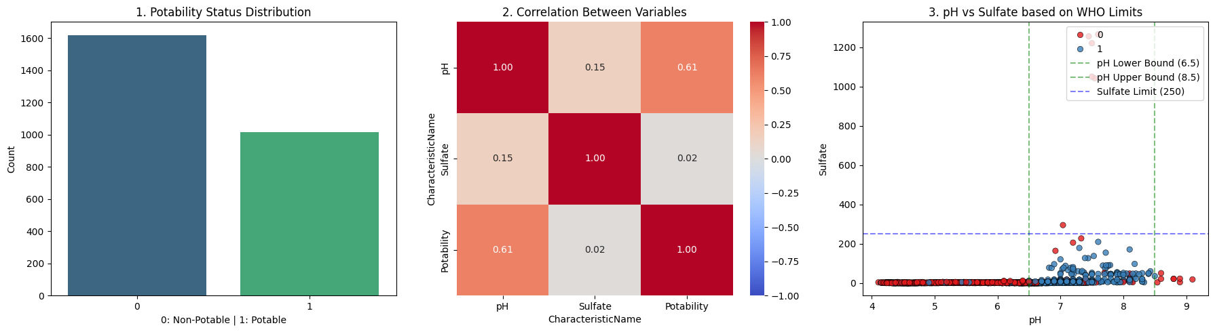
Data
Before model training, exploratory data analysis was conducted to understand class distribution, feature relationships, and compliance with WHO water quality standards.

Slide 7
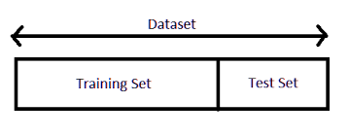
Model Selection and Training / Testing
Model Selection & Training Pipeline
The models were trained using a consistent and leakage-free machine learning pipeline to ensure fair comparison and reliable evaluation.
Key Steps
Dataset split: 80% training / 20% testing (stratified)
Feature scaling using StandardScaler
Class imbalance handled with SMOTE (training only)
Hyperparameter tuning via RandomizedSearchCV (5-fold CV)
Same preprocessing applied to all models for fair comparison

Slide 8
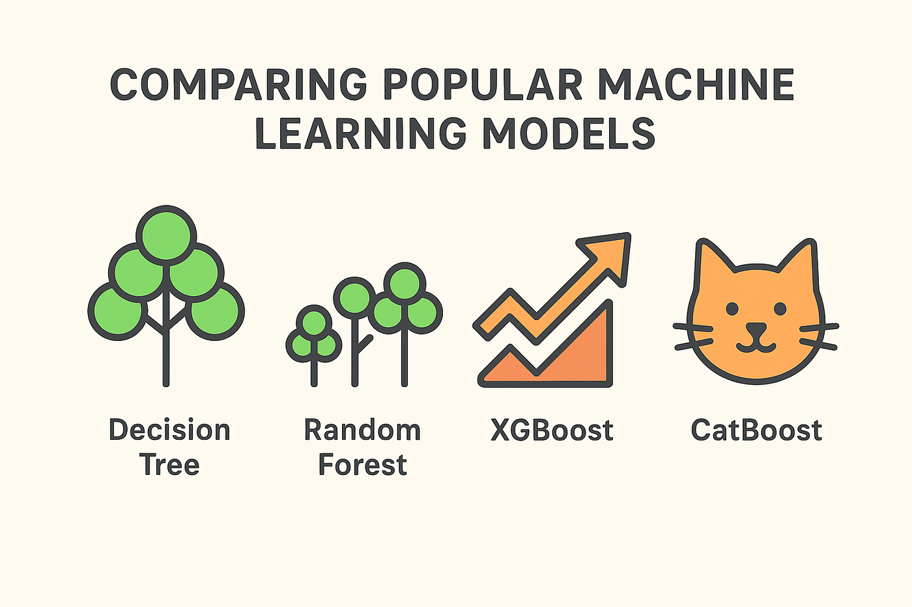
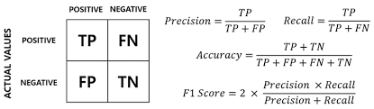
Model Selection and Training / Testing
Model Performance Comparison
Multiple machine learning models were evaluated under identical conditions to ensure a fair comparison of predictive performance.
Key Steps
All models trained with same preprocessing pipeline
Evaluation metrics: Accuracy, Precision, Recall, F1-score, ROC-AUC
Ensemble models outperform linear and distance-based models
Performance trade-offs observed between precision and recall

Slide 9
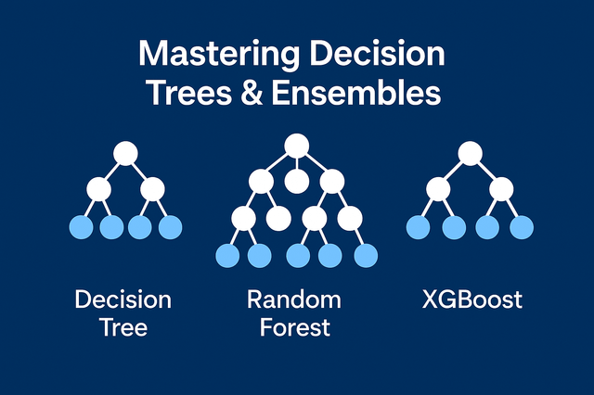
Model Selection and Training / Testing
Key Insights & Final Model Selection
Model evaluation results show clear performance differences between algorithms, highlighting the importance of non-linear and ensemble-based approaches for water quality prediction.
Key Steps
Random Forest provides the best overall balance of performance
XGBoost performs similarly with strong generalization ability
SVM achieves highest recall, but lower overall accuracy
Ensemble methods outperform linear models due to non-linear relationships in data
Recall is prioritized due to public health risk (false negatives)

Slide 10
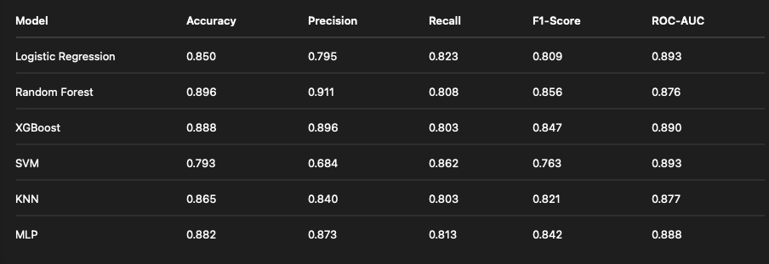
Evaluation Results
Performance Metrics Comparison
The performance of all models was evaluated using multiple classification metrics to ensure a comprehensive and fair comparison.
Random Forest achieves the highest overall accuracy and precision
SVM achieves the highest recall
Trade-off exists between precision and recall across models
Ensemble models show stronger overall stability

Slide 11
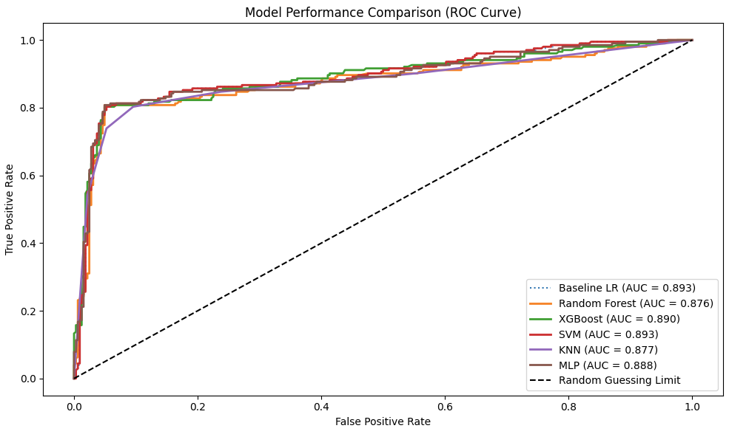
Evaluation Results
ROC Curve Analysis
ROC curves were used to evaluate the trade-off between true positive rate and false positive rate across all models.
All models show strong ROC-AUC performance, indicating good class separability.

Slide 12
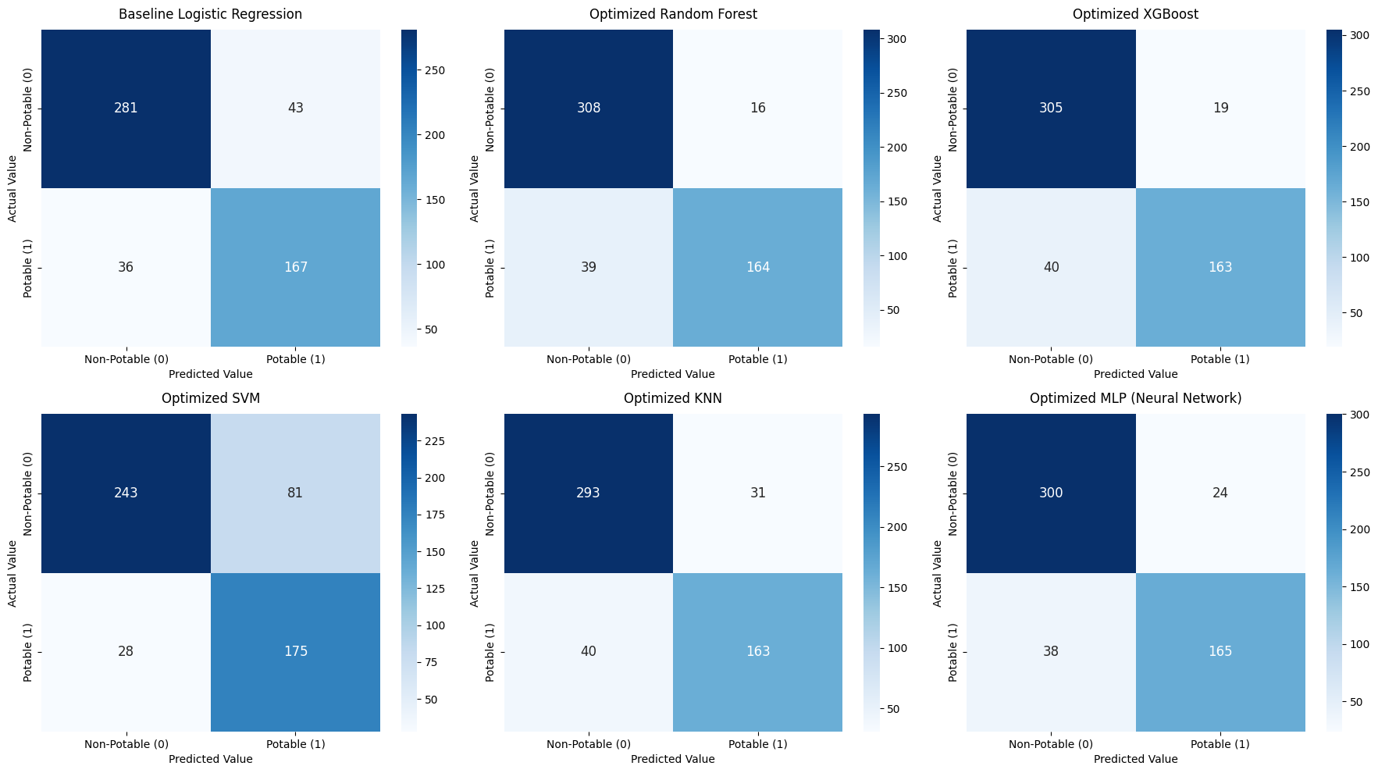
Evaluation Results
Confusion Matrix Analysis

Slide 13
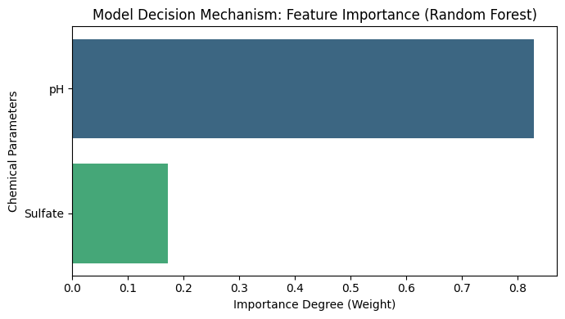
Evaluation Results
Feature Importance Analysis
Feature importance analysis was performed using the optimized Random Forest model to understand how each water quality parameter influences prediction outcomes.

Slide 14
Deployment
We simulated a simple inference process by providing custom input values to the trained model, demonstrating its ability to make real-world predictions.

Slide 15
Thank you!

